Slide 1


React Component Profiling
90min
(confac)
Demos
Code-Show
Theoretical
War Story
FrontendTrack

Slide 2
Performance?
It’s always the database
If it’s not, it’s typically something unexpected
confac reads the entire db in memory at startup … so it’s not the database in this case
Which is good… Otherwise this would be a db perf session!

Slide 3
MENU
Introducing confac
Profiling
Part 1: Easy Pickings
Part 2: The Meaty Part
Part 3: Going Beyond
The future of confac

Slide 4
Part 1: easy pickings
Using the profiler
Easy performance pickings
/invoices page
/monthly-invoicing (projectMonths)

Slide 5

Part 2: the meaty part
More projectMonths optimalizations
Refactorings
Wonders of the IFeature
Refactoring of the store
Reselect createSelector
useMemo & memo

Slide 6
Part 3: Going beyond
More projectMonths optimalizations
Web Worker
<Profiler />
Other low level tools

Slide 7

Menu: SOLD OUT
Pagination
Partial data load
Debouncing
Virtualization & Infinite scroll
Suspense & useDeferredValue
Notes:
Debouncing: Did some testing and filtering was always fast enough after the other performance optimalisations
Virtualization: Actually tried implementing this on the InvoiceList but package support was “in transfer” at the moment (some not React 18, new kid on the block). Before I realized the Profiler extension existed… Pagination: Actually implemented on the InvoiceList later on (removed the need for the debounce I guess)
Partial data load: Also implemented later on (data from 18+ months ago is not very interesting) + added mongo indexes so the database does not become the bottleneck later Suspense: as of React 18
Suspense has been worked on but is stil experimental:
Integrated with opiniated frameworks (Relay, Next.js, Hydrogen, or Remix)
Works best if integrated with Router, server rendering, ...
Suspense & useDeferredValue
Not relevant to confac because data is loaded into memory at startup.
But this looks very promising, I’m curious where they will go with this…
(there is a slide at the end with some details)

Slide 8
Confac?
Facturatieprogramma
Software om de manuale docx facturatie flow te automatiseren
Algemene configuratie, klanten en facturen
Notes:
Demo van toen:
npx http-server confac-initial

Slide 9
Growth with itenium
Consultants
Projects
Monthly follow up (Project Months)
Security (Google Auth, Users, Roles)
Emailing
Audit
Contracting

Slide 10
what happened
Itenium started using confac React (pre-hooks), Redux Node & Express (first few years Koa)
Mongo, docker-compose
confac was first created to hone this (new) tech stack

Slide 11
Let’s Start

Slide 12
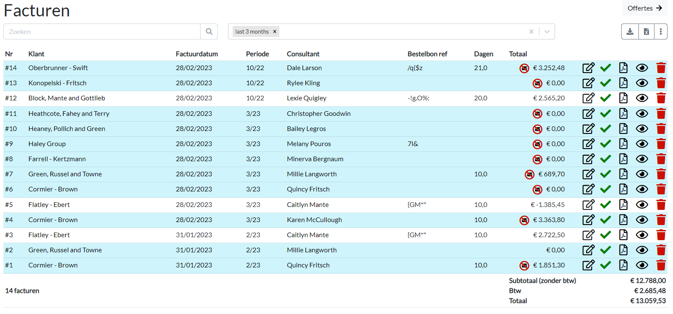
Invoices page

Slide 13
So Performance issues?
On the /invoices page?
Impossible!
I already did a huge performance optimalization there by switching from react-tooltip to rc-tooltip
Notes:
Commit SHA rc-tooltip: c98f49f64
Performance issue on the invoices page: the tooltips for the icons took a long time to render.

Slide 14

First, I tried to trick steven
Notes:
But that trick only worked the first 4 times

Slide 15
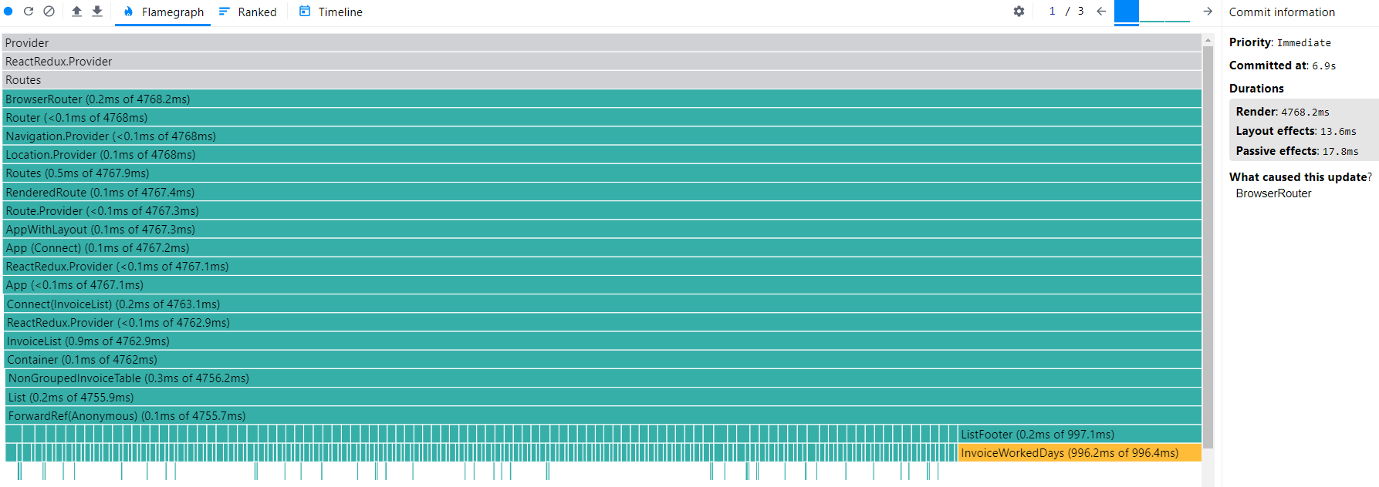
Performance issues?
6 seconds for 100 invoices/rows

Slide 16
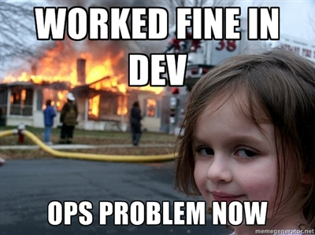
Invoices
Rendering 100 invoices takes 6 seconds.
Well, that's not good.
Notes:
100 invoices would’ve taken me 8 years
Ops problem now:
Then it turned out, I was ops. Damn.

Slide 17
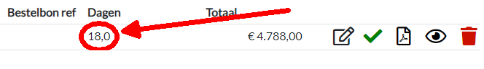
Invoices
Rendering InvoiceWorkedDays takes 1sec (for 100 rows)
Notes:
It wasn’t actually where the screenshot points to but in the footer. (see previous slide)
Still the same component though.

Slide 18
Invoices
DEMO 1
profiling-0-start
Notes:
Branch: profiling
InvoiceWorkedDays Start tag: git checkout profiling-0-start
Solution tag: profiling-0-solution
InvoiceDownloadIcons : SKIP
WithClaim:
Start tag: profiling-2-WithClaim-start
Solution tag: profiling-2-WithClaim-solution

Slide 19
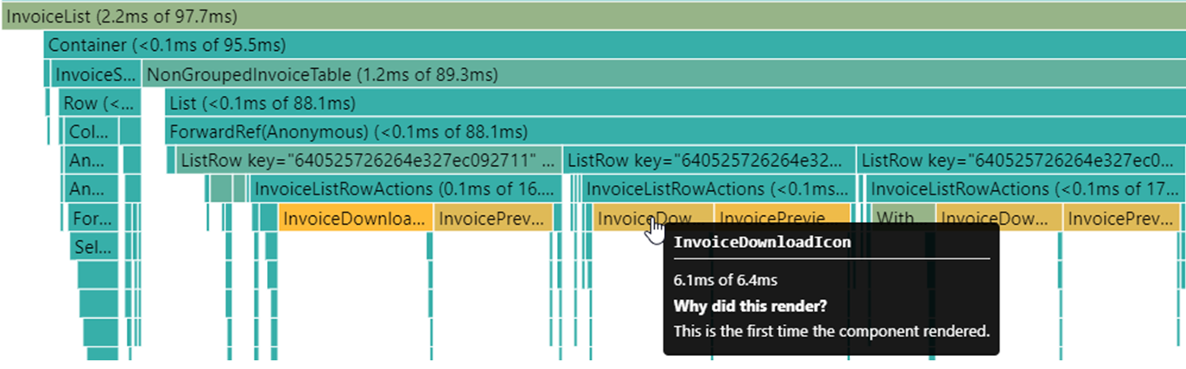
Invoices: Icons

Slide 20
Invoices
6s → 2s
The easiest optimization is just not doing it
InvoiceWorkedDays: do not calculate holidays
InvoiceDownloadIcon & InvoicePreviewIcon: useProjectMonthFromInvoice calculated for all invoices

Slide 21
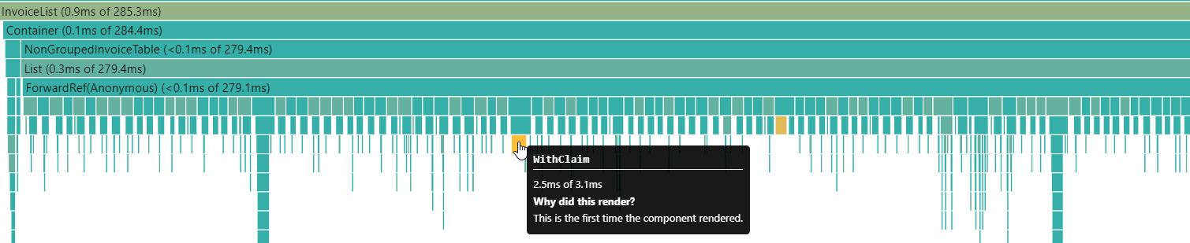
Invoices: With Claim
Profiler: Flamegraph

Slide 22
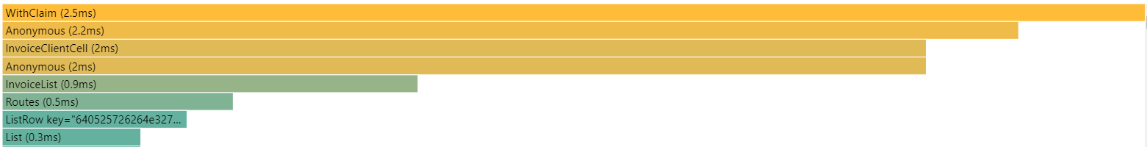
Invoices: With Claim
Profiler: Ranked

Slide 23
Invoices
2s → 360ms
I/O operations are expensive
AuthService: Accessed localStorage for all operations.

Slide 24
Invoices
360ms
360ms. Not great but good enough for now.
Because this was the warmup… There is another screen…

Slide 25
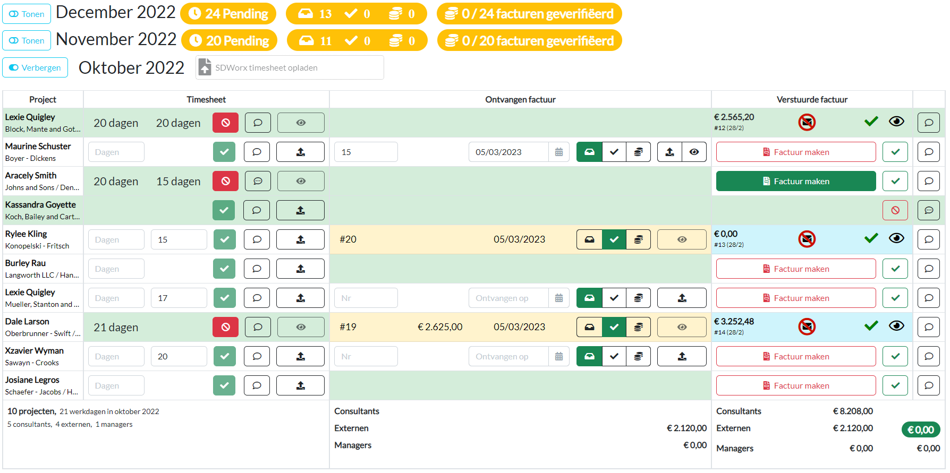
The other screen

Slide 26
Project Months
It’s disastrous
Everything is re-rendered whenever a projectMonth gets collapsed/opened. → Opening more and more projectMonths gets slower and slower
Filters are remembered between route changes → Navigating back can be painfully slow when many projectMonths are opened

Slide 27

Project Months
So, how bad are we talking here?
18 months & 718 projects
First opened with 38 projects:
2nd with 38:
3rd with 76:
4th with 74:
all opened:
renavigate with all opened:
350ms
660ms
950ms
1.2s
5s
4.4s

Slide 28
Project Months
DEMO 2
profiling-3-PM-Footers-start
Notes:
Branch: profiling-2
Start tag: profiling-3-PM-Footers-start
End tag: profiling-3-PM-Footers-solution
The date-holidays dependency.

Slide 29
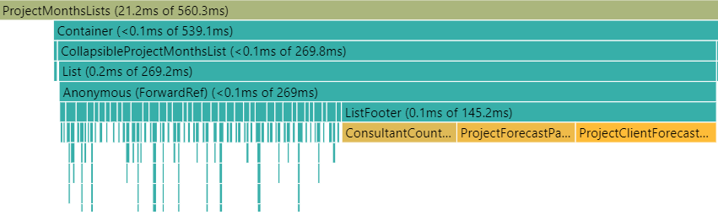
Project Months: footers

Slide 30
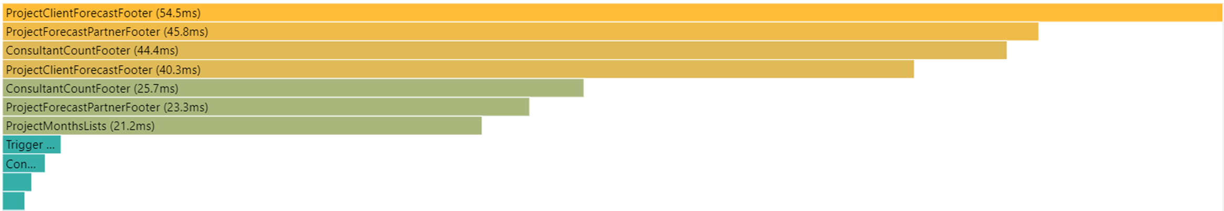
Project Months: footers
Notes:
It’s actually just three footers that show up multiple times.

Slide 31
Project Months: Holidays
Don’t trust 3rd Party Packages (to be performant)
Checking if a day is a holiday is slow?
code is tiny (literally like 30 lines) but… the… dependencies …
date-holidays-parser: 160kb
astronomia:
/data: 8,6MB JS
/src: 500kb
confac itself is 500kb (src folder)
Notes:
And further dependencies:
Caldate, date-bengali-revised, date-Chinese, date-easter, deepmerge, jalaali-js, moment-timezone, etc
The data load:
https://github.com/commenthol/astronomia
https://github.com/commenthol/astronomia/tree/master/data

Slide 32



Date-holidays
It’s using classes, which are not treeshakable
10MB JS executed 😀
to check for a Belgian holiday
Notes:
There wasn’t a single time when I used a class in JavaScript and later thought, “That was a good idea” (including a few times in confac)
So yeah, stick to functions (unless you really need a class) 😃
Why maybe still do classes: need “this”, “instanceof” or lots of internal object logic?
Could also just have looked for another package which does just the Belgian holidays…

Slide 33
Holidays Cache
Remember: with caching comes cache invalidation
There are only two hard things in Computer Science: cache invalidation and naming things. -- Phil Karlton
and off by one errors.
But luckily for me, past Belgian holidays are literally never going to change!
Notes:
Phew, crisis averted!

Slide 34
Project Months
The holiday caching aftermath
18 months & 718 projects
First opened with 38 projects:
2nd with 38:
3rd with 76:
4th with 74:
all opened:
350ms → 220ms
660ms → 320ms
950ms → 540ms
1.2s → 680ms
5s → 1.7s

Slide 35
Take Aways
The profiler is pretty awesome
Not doing a calculation or render is the best optimalization
Keep an eye on 3rd Party packages
I/O Operations are expensive
Notes:
I/O: Be it db access, or localStorage

Slide 36
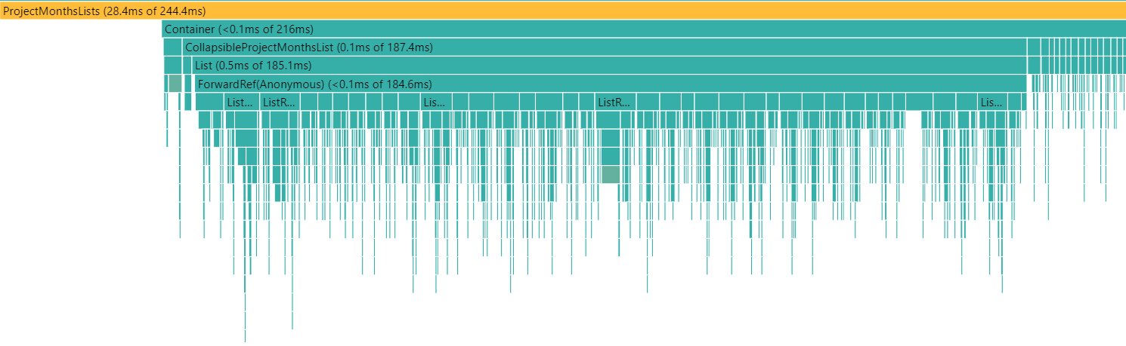
Project Months Holiday Caching Aftermath
A more even distribution now… So no easy performance targets
Notes:
A more even distribution now… So no easy performance optimalization targets.

Slide 37

‘‘Break’’
No easy perf target? Uuuh… Okay, let’s take a…
Quick, divert them with a meme
Notes:
So now the joke is, no easy performance targets? This session is over!! Break? I’m not coming back 😃
But first try to divert attention to this hot potato with the story of how one guy broke every CI in the world.
On 23 March 2016 Azer Koçulu unpublished all his code from npm over the Kik dispute.
By deleting Just 11 lines of code (left-pad) he broke stuff like Babel, so basically every JavaScript project.
The same thing happened with Jade templating library (=Jade is a trusted IT services partner for global enterprises), so they renamed to “Pug” – which is used in confac (pug -> html -> pdf)
I remember that that morning my “npm install” failed.

Slide 38

Refactoring In Progress
(unrelated to performance)
Notes:
There really is a break: can go for a drink or a snack, we’ll be back in 5minutes?
I’m merging a refactoring for easier deployment (joining of three separate repositories into one)
(with npm install & stuff, you know…)

Slide 39
Project Months
The Goal: Avoid rerenders when just the filters change

Slide 40
Project Months
DEMO 3
profiling-4-start
Notes:
DEMO:
Show how slow it is on profiling-4-start
Then proceed with the other tags → See Storybook.md

Slide 41
Project Months
1) Delaying the IFeature construction 2) Specific query for the CollapsedProjectMonth
320ms → 160ms
2nd with 38:
4th with 74:
all opened:
680ms → 304ms
1.7s → 3.4s

Slide 42
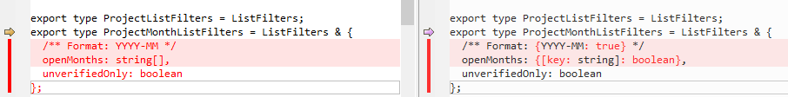
Project Months
3) Changing the structure of the filters in the store
Notes:
User opens/closes a projectMonth:
The array: Even if a particular projectMonth has not changed, the array containing whether it is open/collapsed has changed, so a re-render is triggered
The object: Allows us to select a Boolean to find out whether a projectMonth is opened/collapsed

Slide 43
Reselect
Step 4: Cache the expensive mapping to FullProjectMonthModels & CollapsedProjectMonthBadgeTotals
RESELECT
A library for creating memoized "selector" functions. Commonly used with Redux.
Comes with @reduxjs/toolkit

Slide 44
memoize
To store the result of a computation so that it can be subsequently retrieved without repeating the computation.

Slide 45
Usememo hook
(included in React)
Skip expensive recalculations
useMemo(calculateValue, dependencies)
(see snippets/useMemo.md for more use cases & examples)

Slide 46
Project Months
DEMO TIME

Slide 47
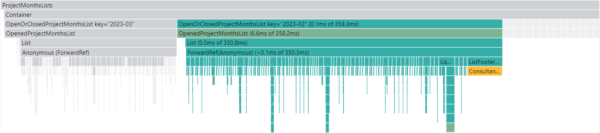
Project Months
useMemo & createSelector & memo
Left: no rerender: earlier opened projectMonth Middle: The opened projectMonth
Right: Completely cached the collapsed projectMonths

Slide 48

Project Months
useMemo & createSelector & memo
18 months & 718 projects
150ms → 170ms
2nd with 38:
4th with 74:
all opened:
renavigate with all opened:
304ms → 311ms
3.4s → 140ms
4.4s → 2.8s
Notes:
Whaaaaaat: useMemo, createSelector etc also takes computing time! (there are now also more components to render, or could be just difference in my PC CPU usage when profiled, or who knows…)

Slide 49

Project Months
The Goal: Avoid rerenders when just the filters change

Slide 50
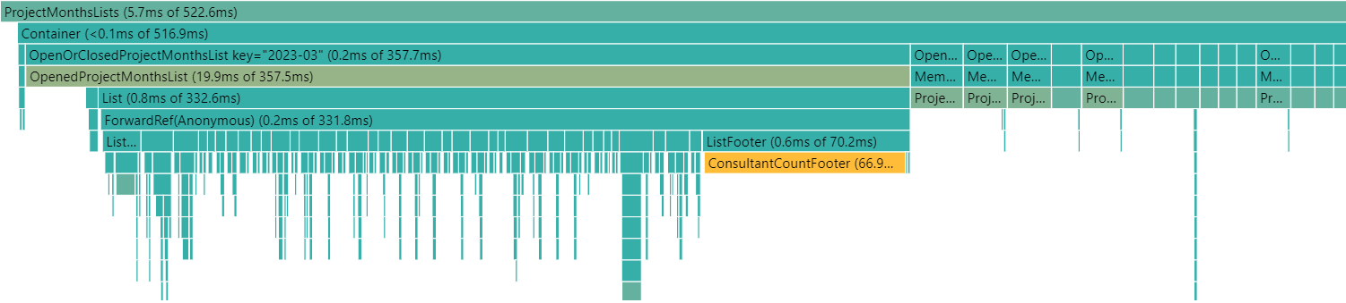
Project Months
So… What about initial page load?
The application starts with the projectMonths screen…
There comes our little holiday dependency lurking again

Slide 51
Take Aways
Depend on as little as possible Components should rely on their minimum requirements of state and props only Prefer props only for low level components
Cache expensive calculations createSelector, useMemo & memo are your friends
Fallback to console.time & <Profiler /> For lower level profiling

Slide 52
Take Aways
Overall structure and code quality has improved due to the refactorings needed to realize the performance targets
More components with finer grained purpose result in a clearer component hierarchy
Improved folder structure to group components
Components now depend only on what they need
Complexity has increased but it is hidden away in hooks and selectors

Slide 53
Take Aways
The IFeature
”Weeks of coding can save you hours of planning.“ -- Fred Brooks

Slide 54

BREAK

Slide 55
Other Optimalizations
Web Worker to delegate work
useCallback for caching event handlers
Avoid inline styling created in render
Components without props can be cached

Slide 56

The survivors

Slide 57
Project Months
Let’s take care of this holiday nonsense once and for all
We will obviously not write the 200 lines it would take to implement this manually
Notes:
Implementation in PHP:
https://gist.github.com/willemwollebrants/99b4349702f438acb9371ae9a8ef2b0f

Slide 58
Project Months
Web Worker
Run scripts in a background thread
Without interfering with the UI
Perform I/O with fetch
Send messages using event handlers

Slide 59
Project Months
DEMO TIME

Slide 60

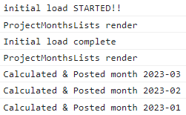
Project Months
The render happened before the first result was in
Notes:
Because there is no fallback in the component itself (to just calculate the date adhoc), it now displays “undefined” :)

Slide 61

Project Months
The holiday performance issue persists…

Slide 62

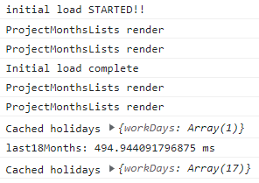
Project Months
I swear this works on the production dataset
I don’t know why there are now two renders. I don’t want to talk about it :)
The first result is returned as it is calculated The rest is sent in batch after

Slide 63
Project Months
I figured it out…
useDocumentTitle('projectMonthsList');
console.log('ProjectMonthsLists render');
const projectMonths = useSelector((state: ConfacState) => state.projectsMonth);
const uniqueMonths = projectMonths
.map(projectMonth => projectMonth.month.format(ProjectMonthsListFilterOpenMonthsFormat))
.filter((month, index, arr) => arr.indexOf(month) === index)
.sort((a, b) => b.localeCompare(a));
console.log('ProjectMonthsLists render');
Notes:
Auto merged ☺

Slide 64
Profiler
render(
<App>
<Profiler id="Navigation" onRender={callback}>
<Navigation {...props} />
</Profiler>
<Main {...props} />
</App>
);

Slide 65
PROFILER
Collapsed ProjectMonth Badges
DEMO TIME

Slide 66
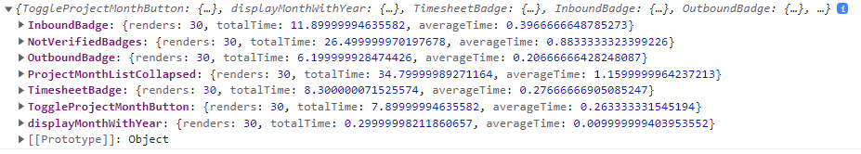
PROFILER
Low Level Profiling of
the ProjectMonthListCollapsed Badges

Slide 67
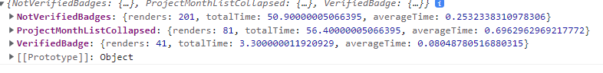
PROFILER
Aggregated Results

Slide 68
Profiler Icons & Badges
Revert to basic html components
Avoid inline styling created in render
Components without props can be cached

Slide 69



Slide 70
Other Tools
useCallback: To have a fixed event handler function (see Icon.tsx)
useWhyDidIUpdate: Present in many npm React hook-collections
useDebugValue(value, format | formatFn?) Can be used in custom hooks.
Notes:
useCallback: This one would be pretty handy to use in components like the Icon that have an expensive RcTooltip
useWhyDidIUpdate: Didn’t think it would be useful at any point during this exercise
useDebugValue: Not for your every day use!

Slide 71
Other Tools
useDeferredValue
a React Hook that lets you defer updating a part of the UI
Showing stale content while fresh content is loading
Indicating that the content is stale
Deferring re-rendering for a part of the UI

Slide 72
The Future of confac? Technical
- A redesign of the store structure
- A rethinking of the `feature`
- createSelector() at the highest level
Extract selectors in custom hooks
And then wait for the next performance issue…
Notes:
Met dan ook natuurlijk integratie met de itenium slack chatbot…

Slide 73
The Future of confac? Functional
Consultant single source of truth?
Skill Matrix bijwerken en zoeken
Downloaden documenten
Indienen ziekte dagen
Bekijken projecten andere consultants (tech stack, …)
…
Notes:
Met dan ook natuurlijk integratie met de itenium slack chatbot…

Slide 74

And that’s really it

Slide 75
Resources
Confac: https://github.com/itenium-be/confac
See README.md for interesting links
Snippets for examples of reselect, useMemo etc

Slide 76
Infos
WiFi: itenium-guest / Wifi4Ufree

